Slide 1
Design pattern

Slide 2
What is Design pattern ?
general repeatable solution to a commonly occurring problem in software design.
template for how to solve a problem

Slide 3
3 types of Design pattern
Creational
Behavioral
Structural

Slide 4
Talks about the creation of objects.
Creational Design Pattern

Slide 5
concerned with the interaction and responsibility of objects
Behavioral Design Pattern

Slide 6
simplifies the structure by identifying the relationships
Structural design pattern

Slide 7
23 Design patterns
Creational
Behavior
Creational
Factory Method
Abstract Factory
Singleton
Prototype
Builder
Object Pool
Adapter
Bridge
Composite
Decorator
Facade
Flyweight
Proxy
Chain of Responsibility
Chain of Responsibility
Interpreter
Iterator
Mediator
Memento
Observer
State
Strategy
Template
Visitor
Null Object

Slide 8
Singleton design pattern

Slide 9
Restricts the instantiation of a class to one "single" instance

Slide 10
Adapter design pattern

Slide 11
Adapter pattern is used when
Two class has different interface
2. We will use an intermediate class to use the other class without changing or modifying it

Slide 12



A sample example
European wall outlet
3 pin plug
3 to 2 pin adapter

Slide 13
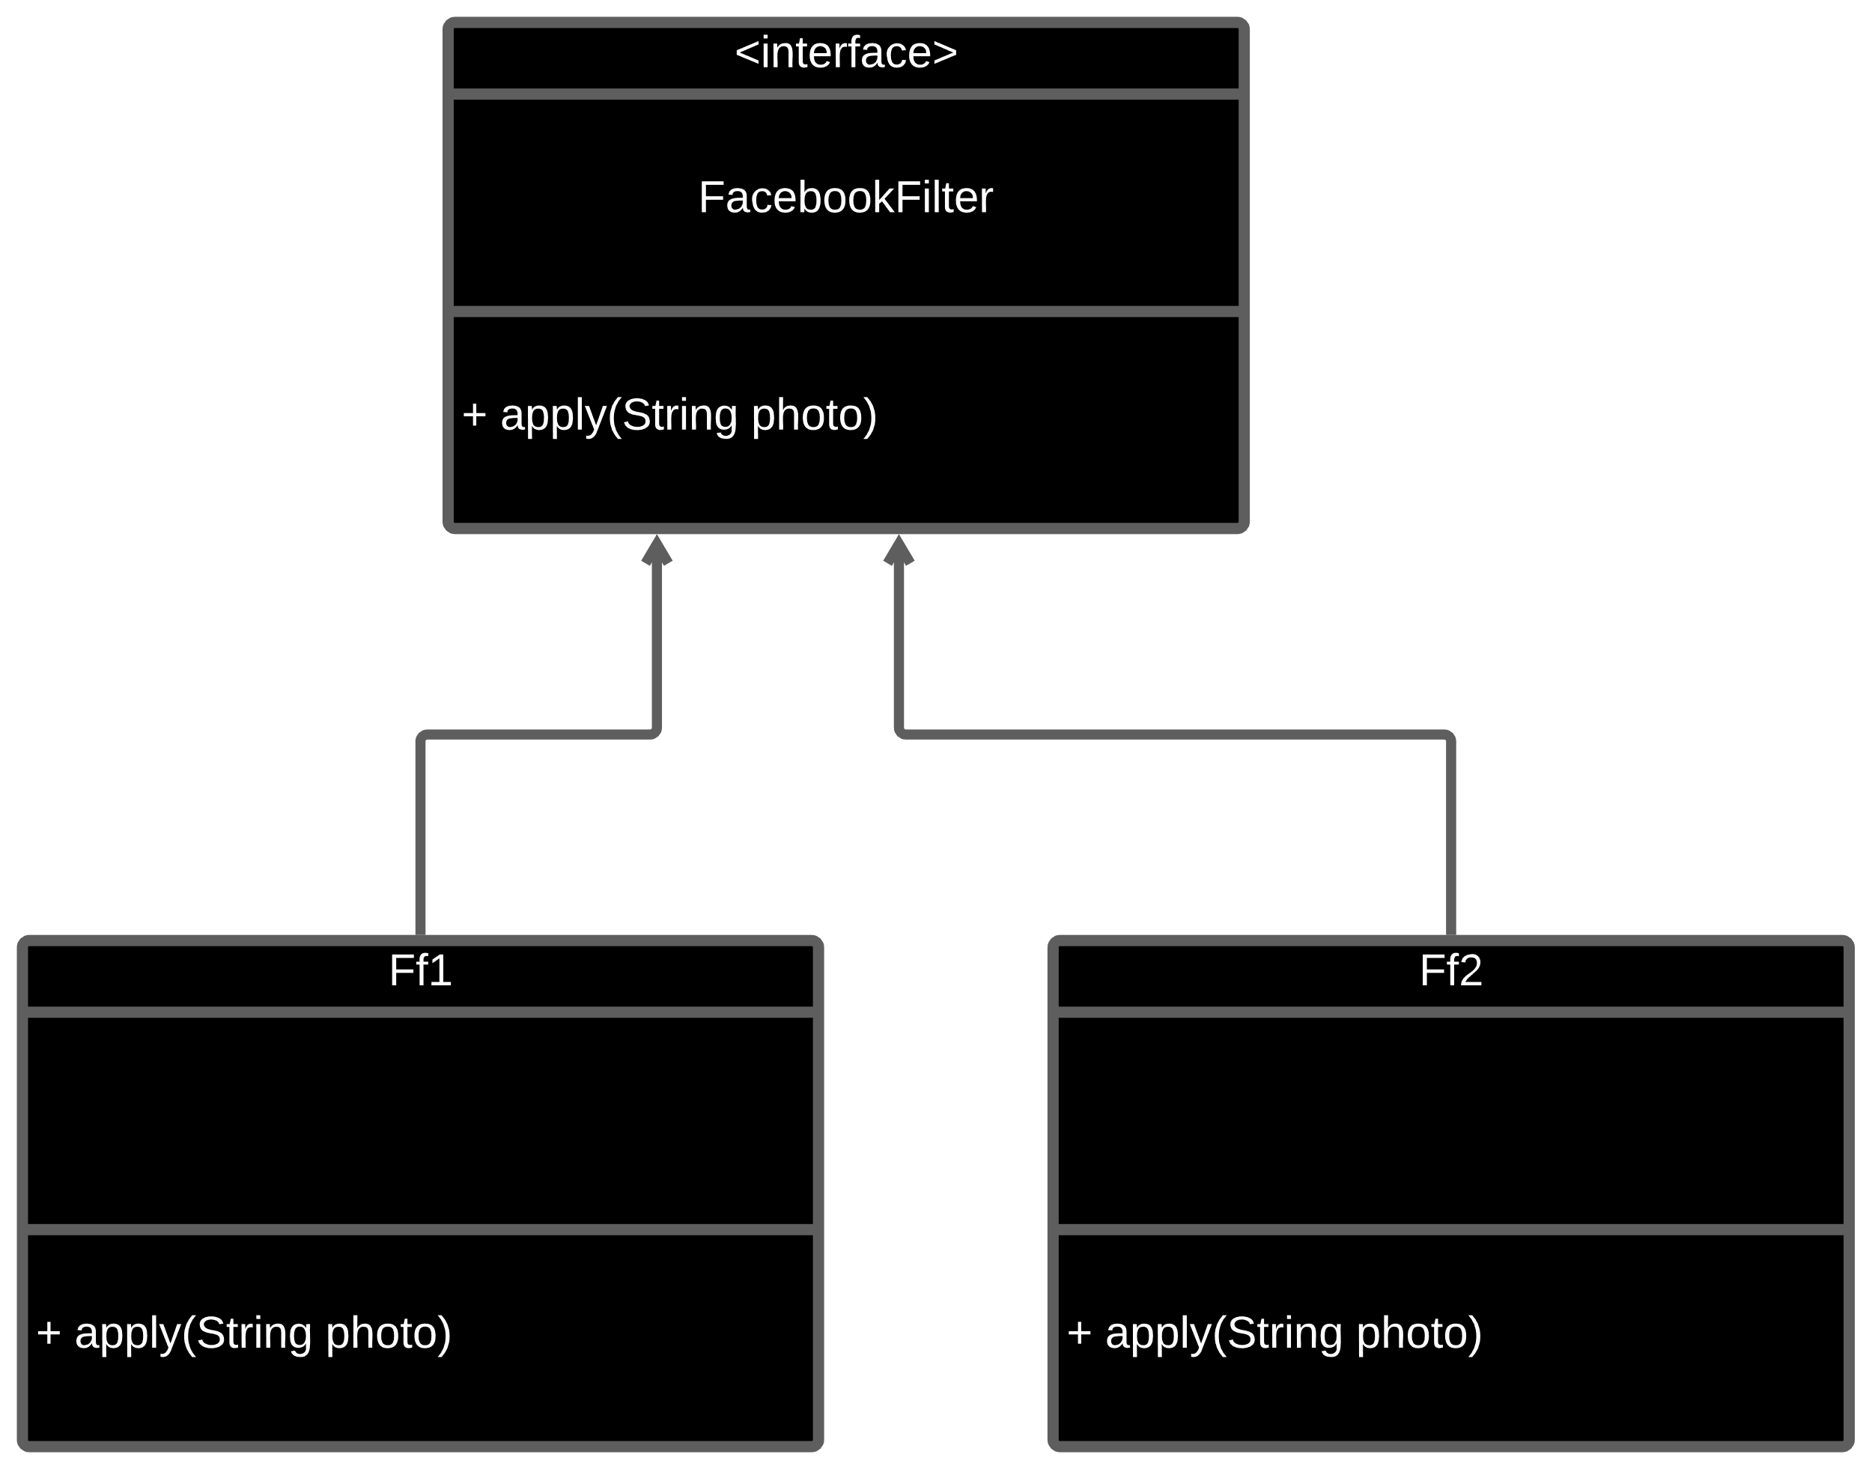
The problem

Slide 14
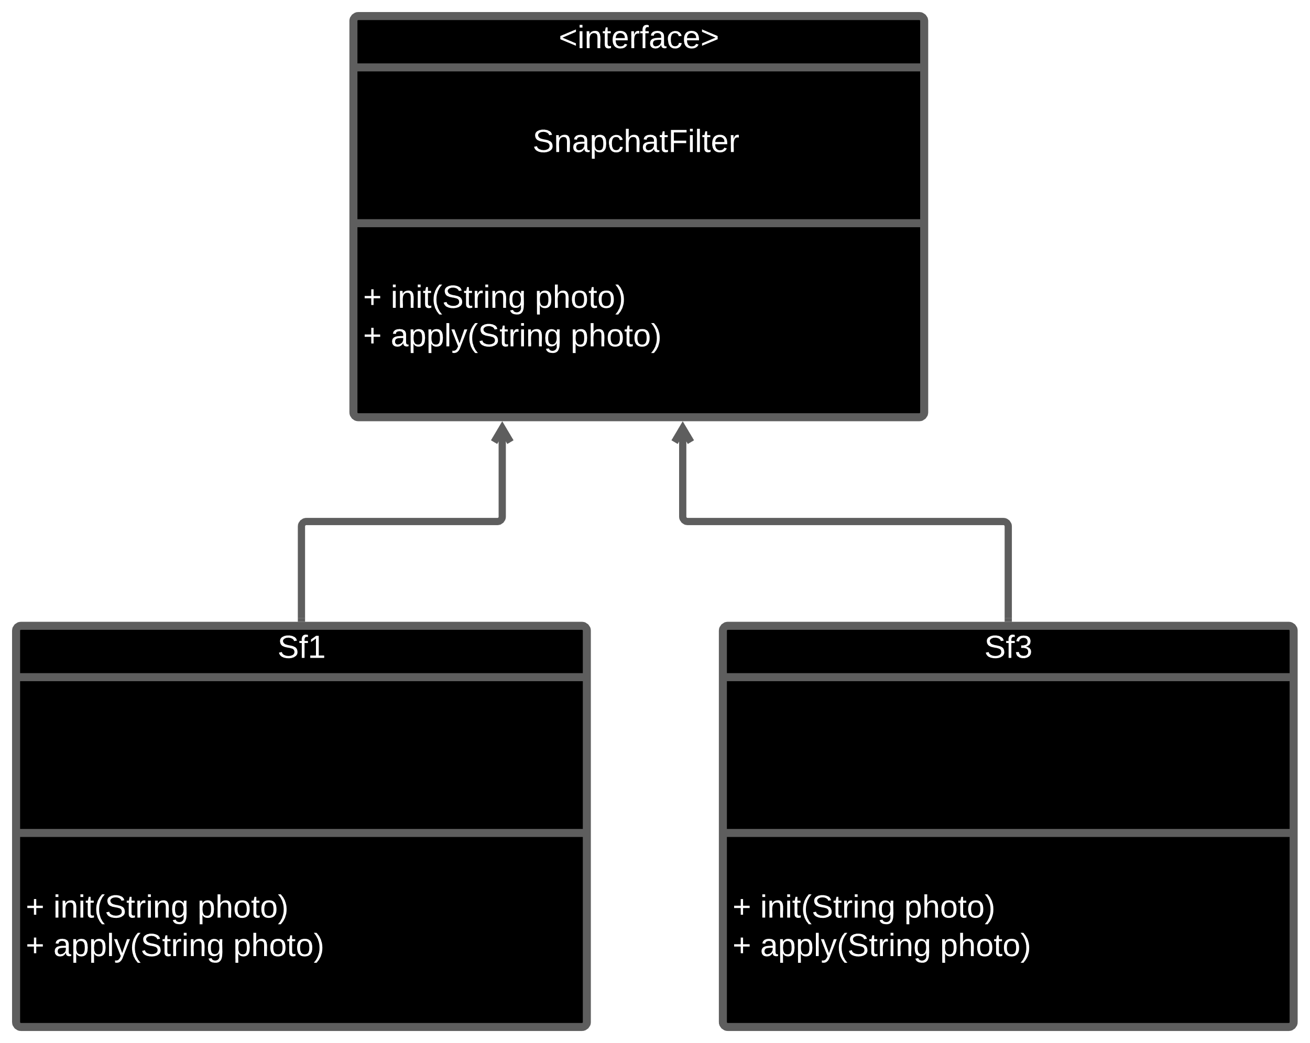
The problem

Slide 15
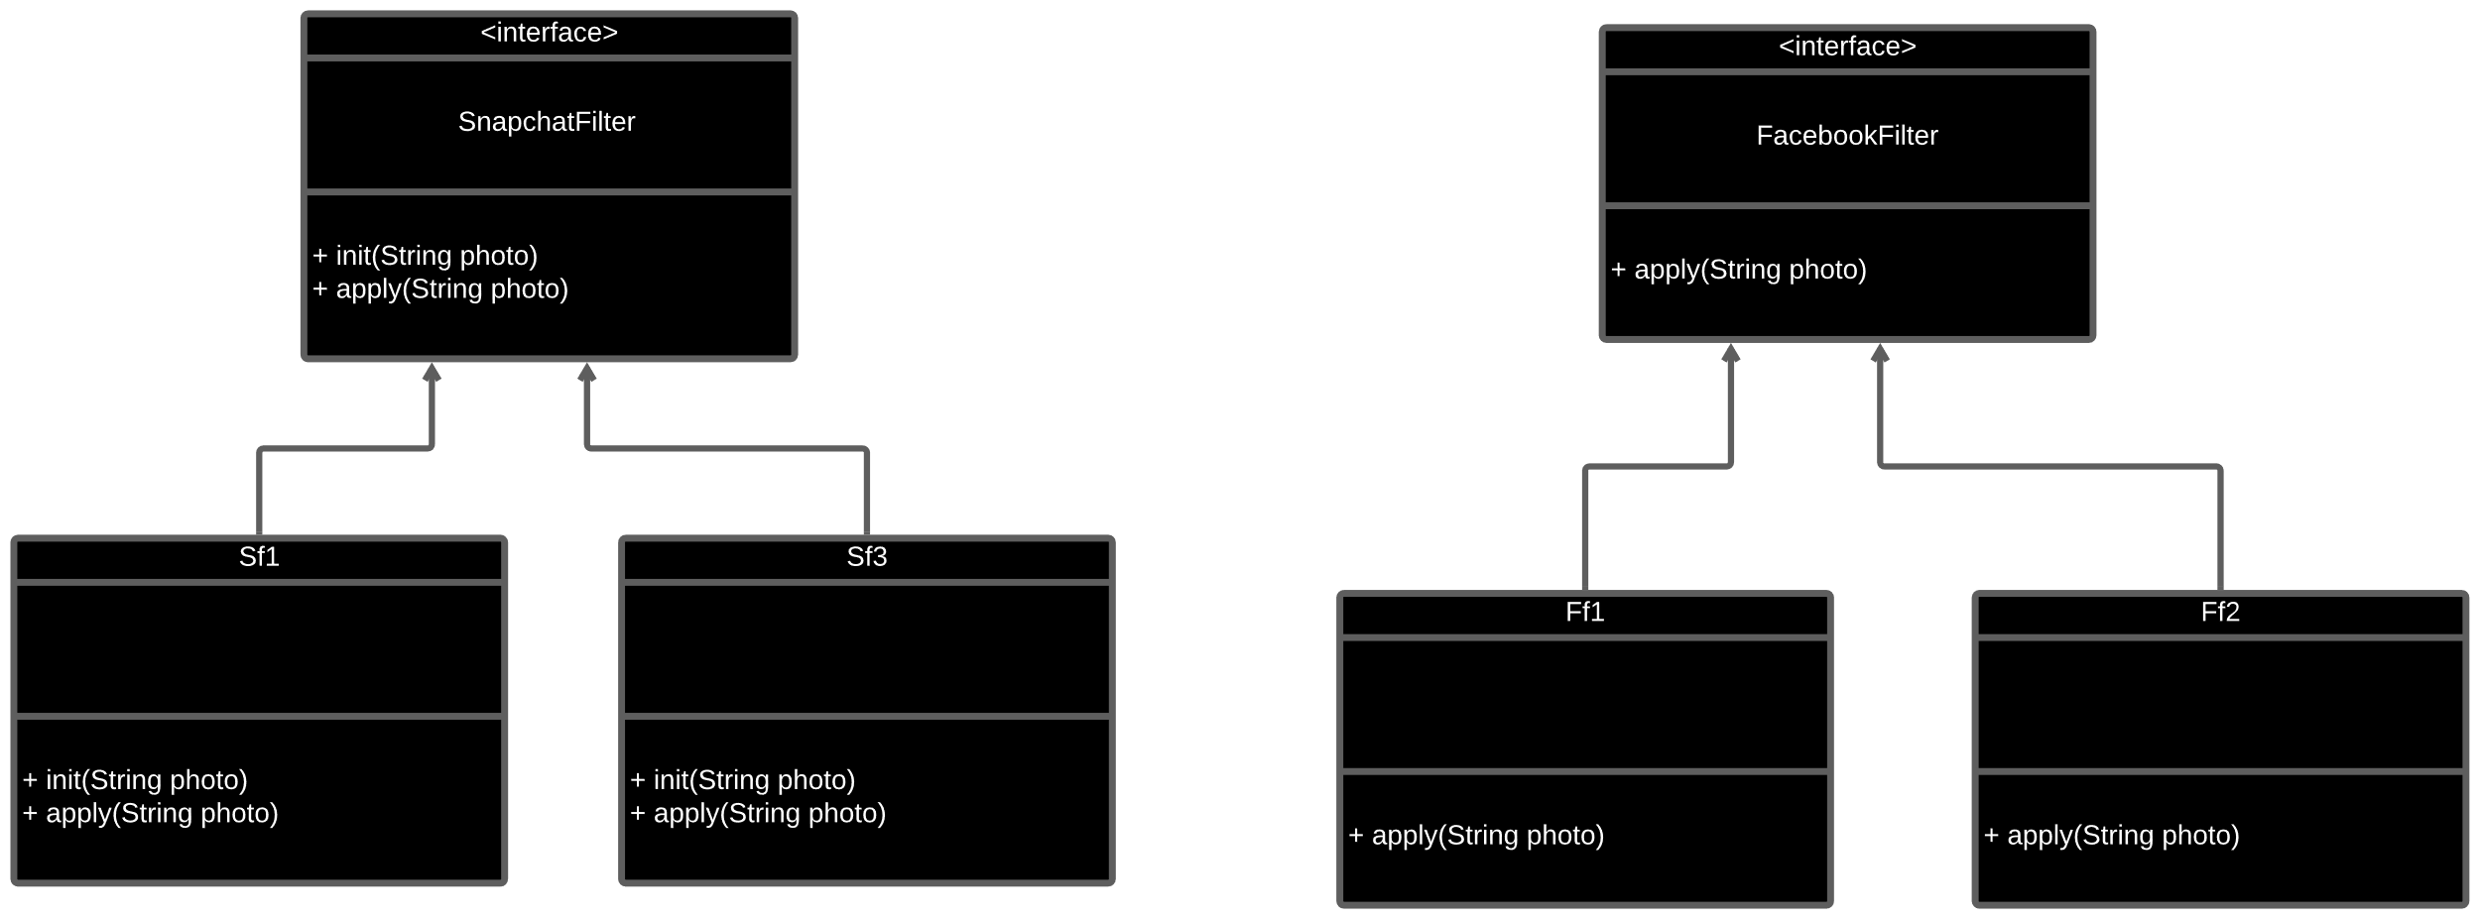
The problem
Different interface !!!

Slide 16
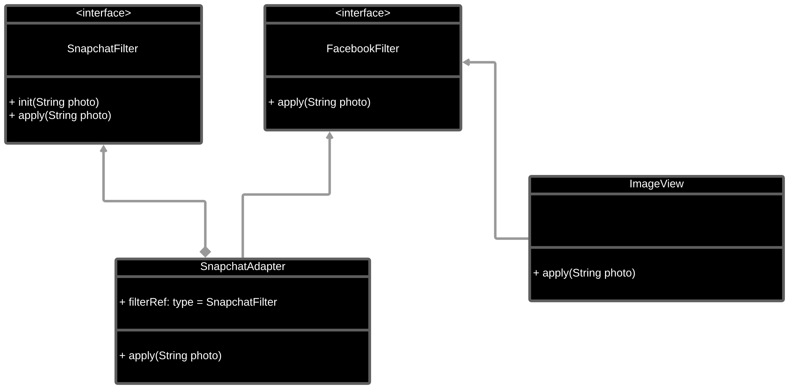
Implementation

Slide 17
Observer Design Pattern

Slide 18
Properties of observer pattern:
1. One to many dependency
2. When one object changes, all of it’s dependents are notified and update automatically

Slide 19


A sample case
User1
User6
User2
3Blue1Brown
User5
User3
User4

Slide 20
Pull Strategy
User1
User6
User2
3Blue1Brown
User5
User3
User4

Slide 21
Push Strategy
User1
User6
User2
3Blue1Brown
User5
User3
User4

Slide 22
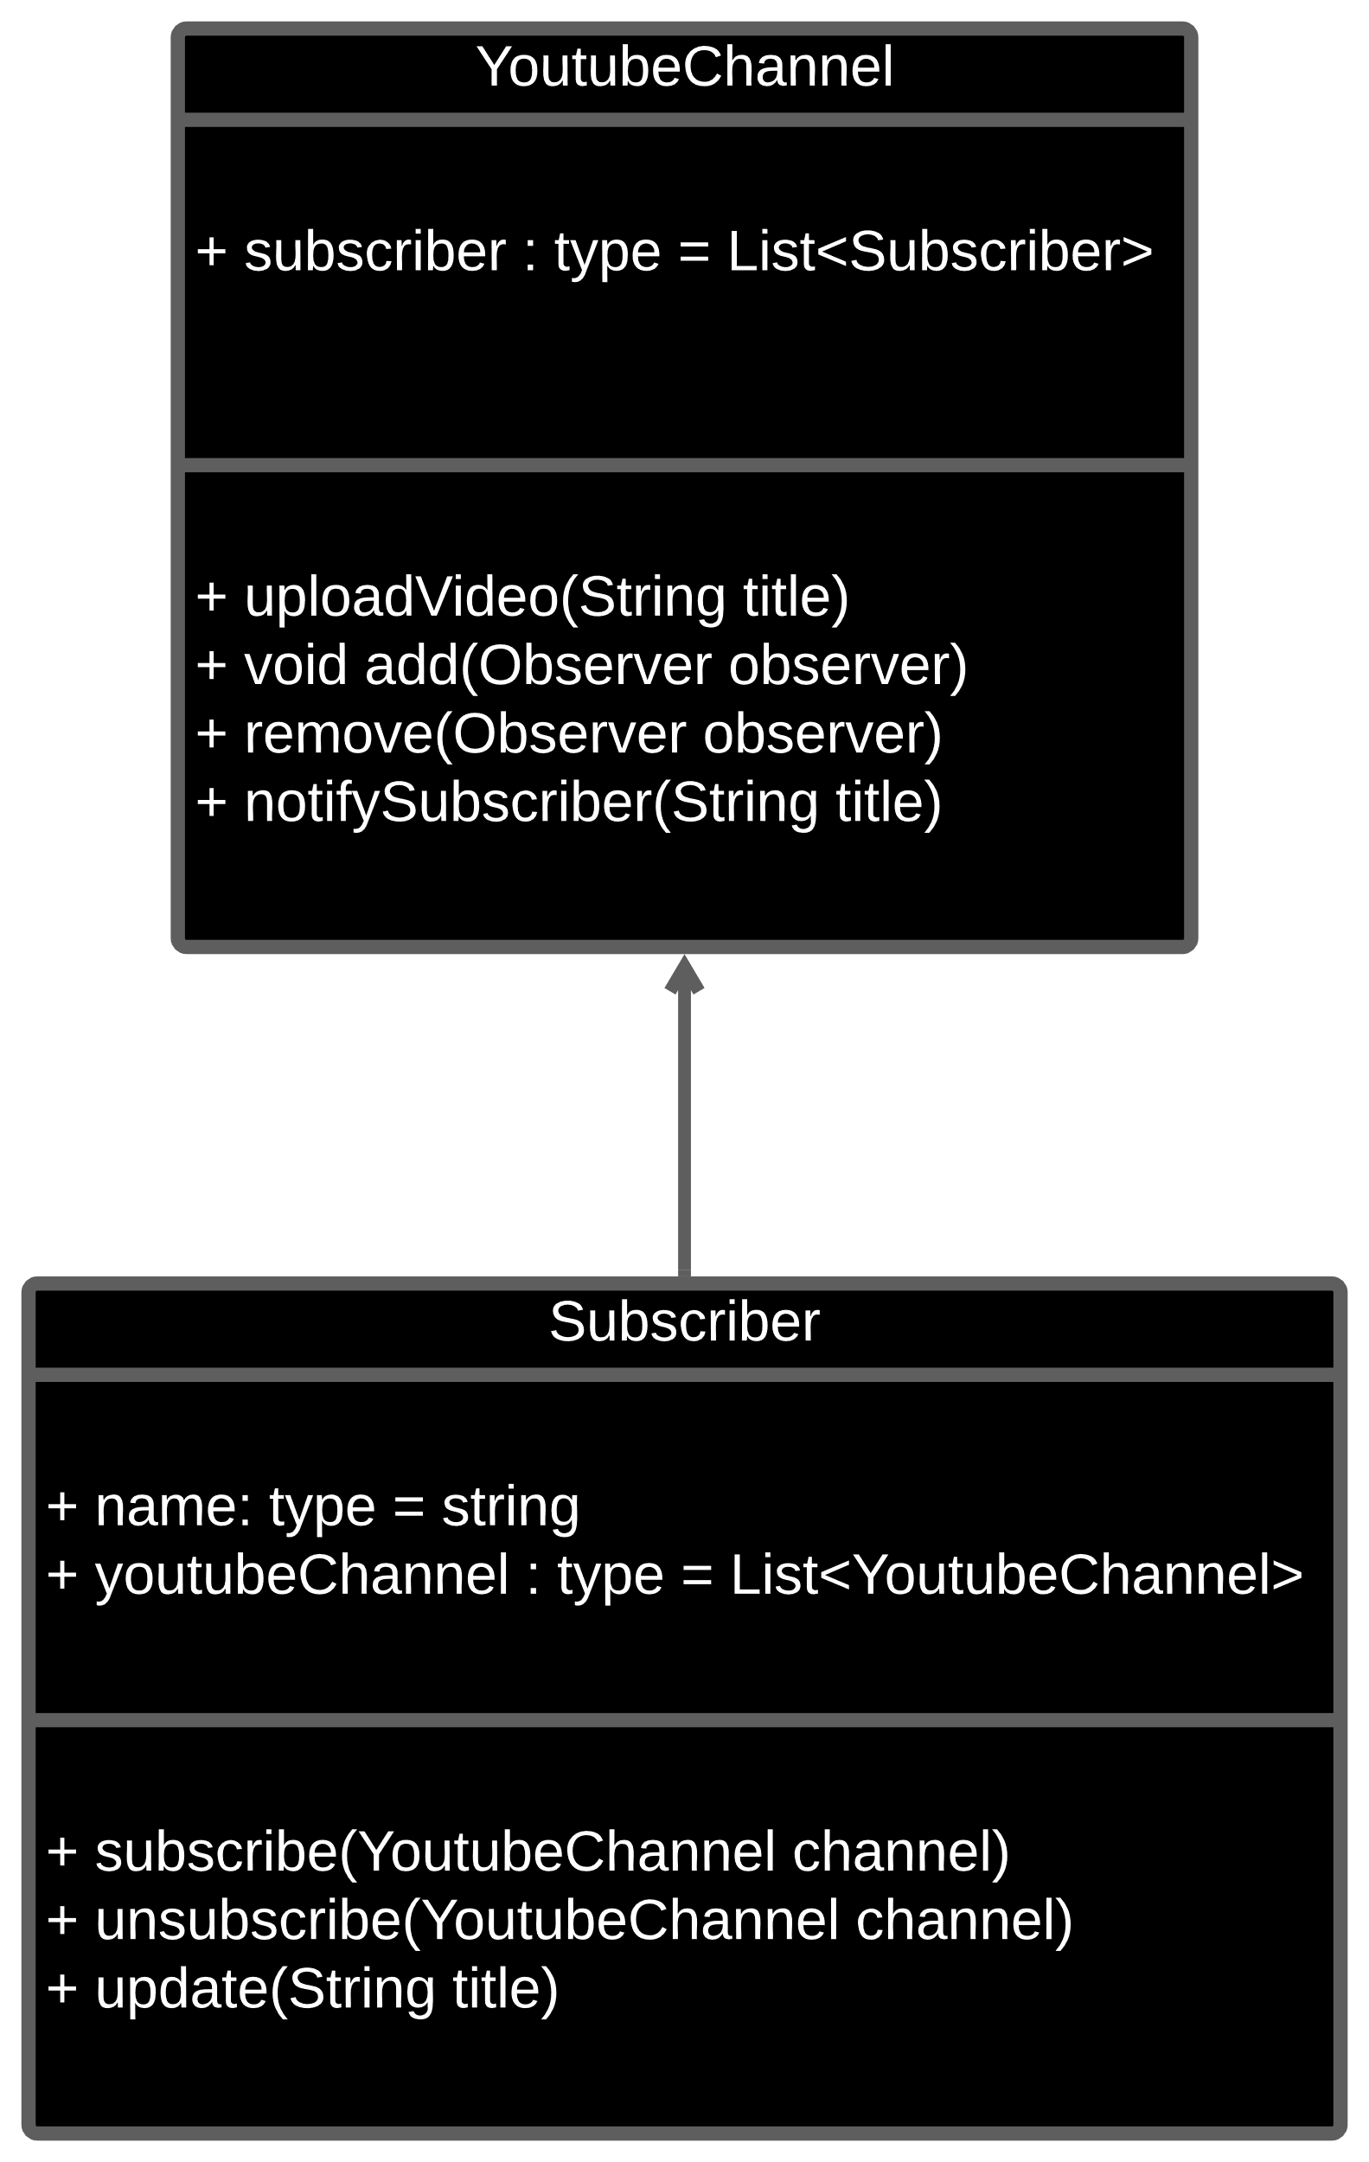

Slide 23
Prototype design pattern

Slide 25
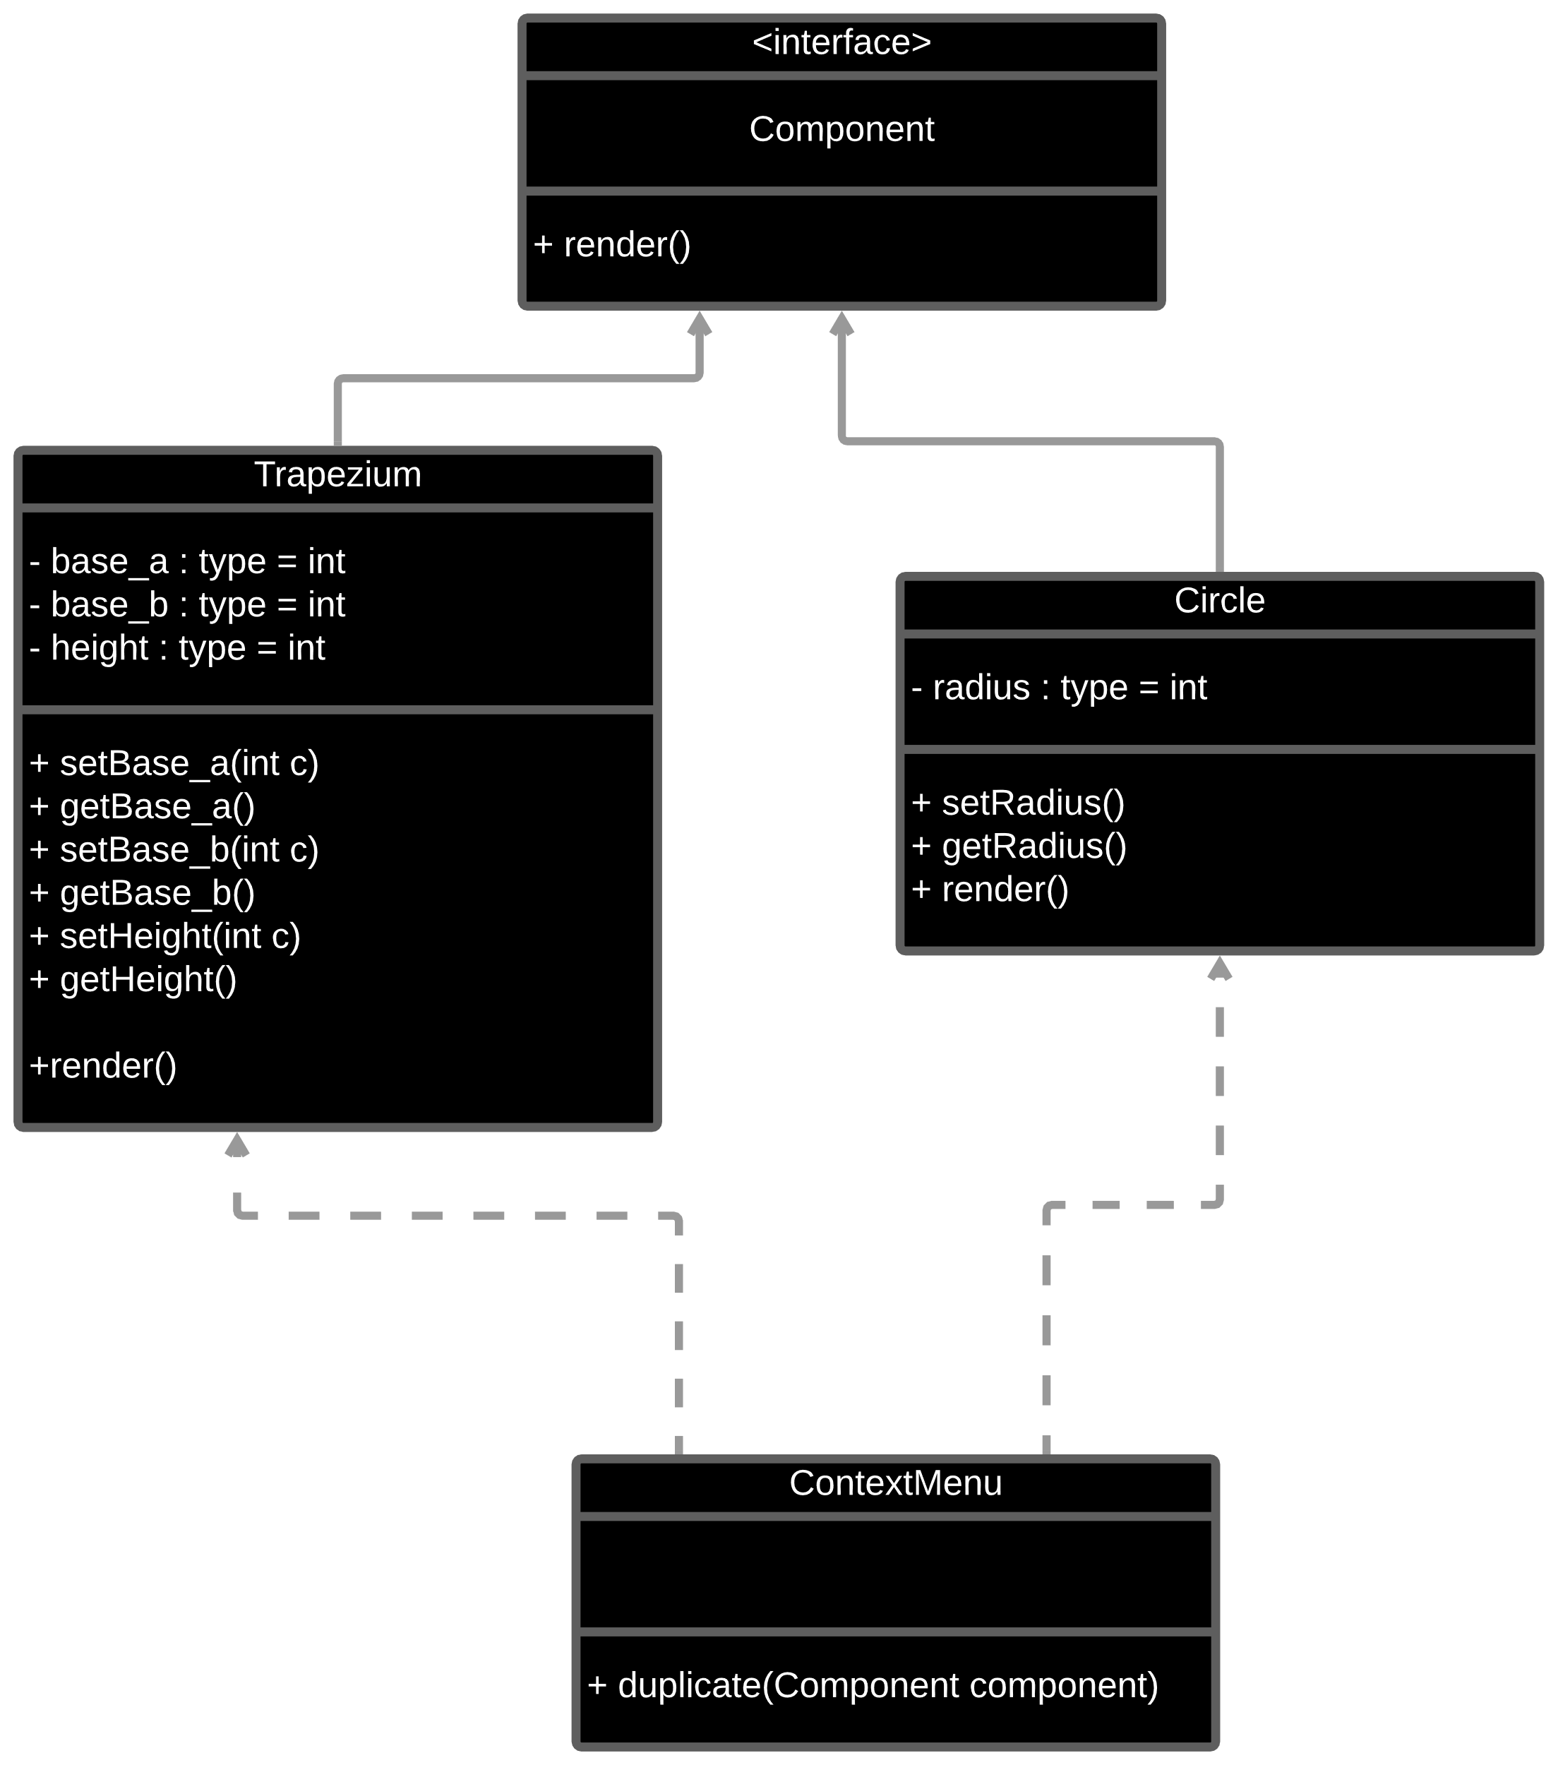
Problem

Slide 26
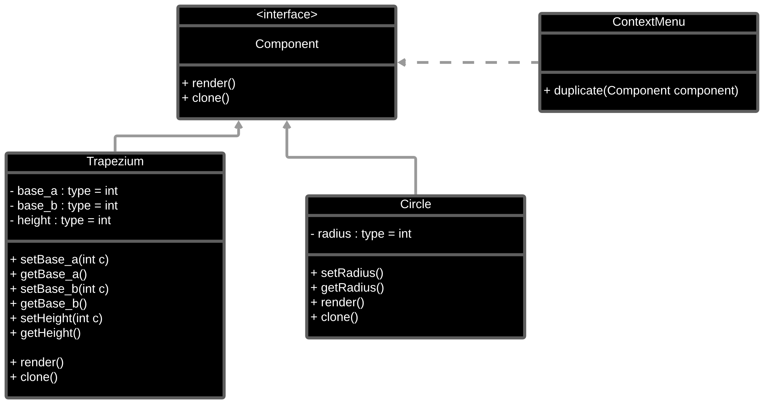
Solution

Slide 27
Strategy Design Pattern

Slide 28
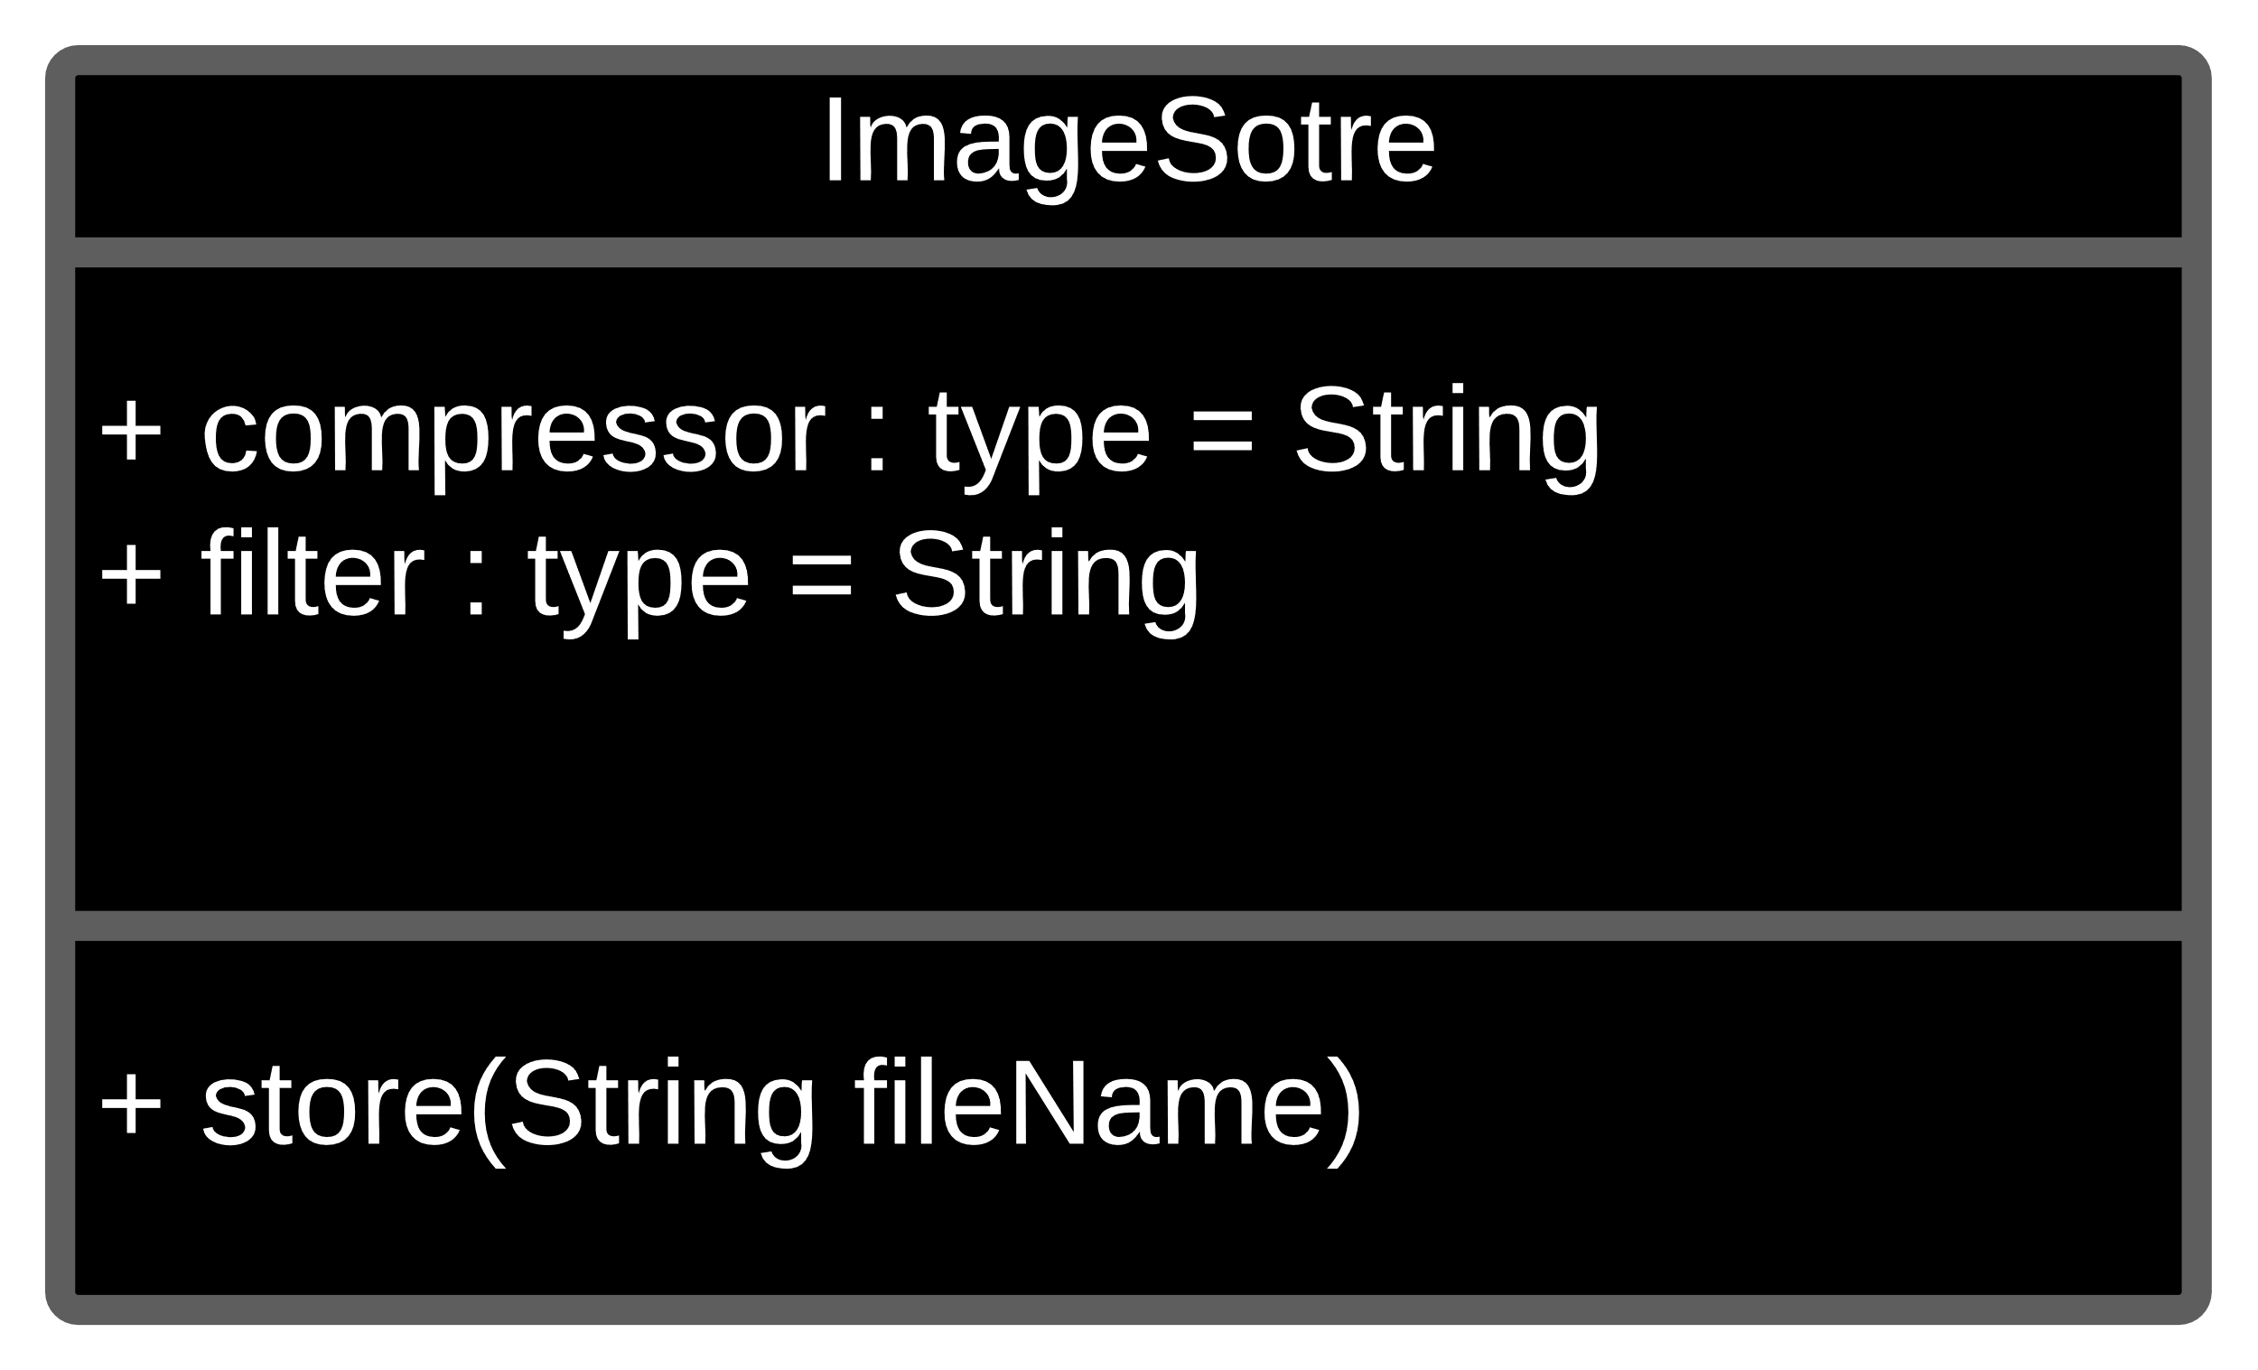
problem

Slide 29
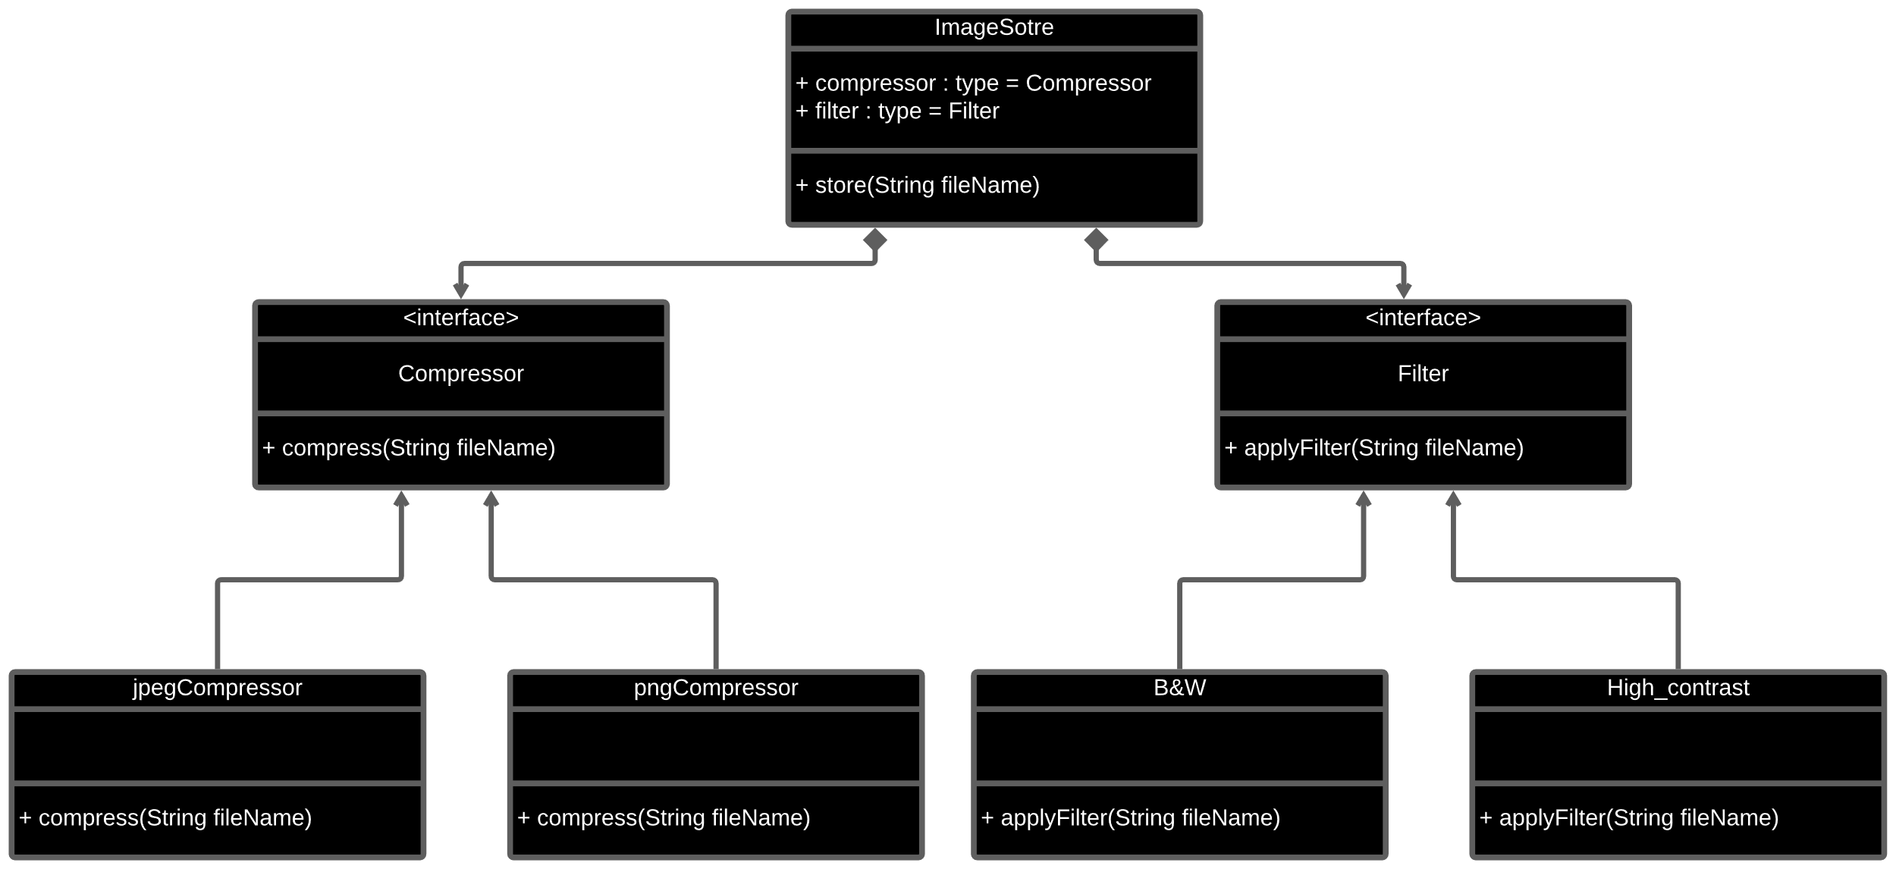
Solution

Slide 30
Facade Design Pattern

Slide 31
Properties of observer pattern:
Provides simple interface to the user

Slide 33
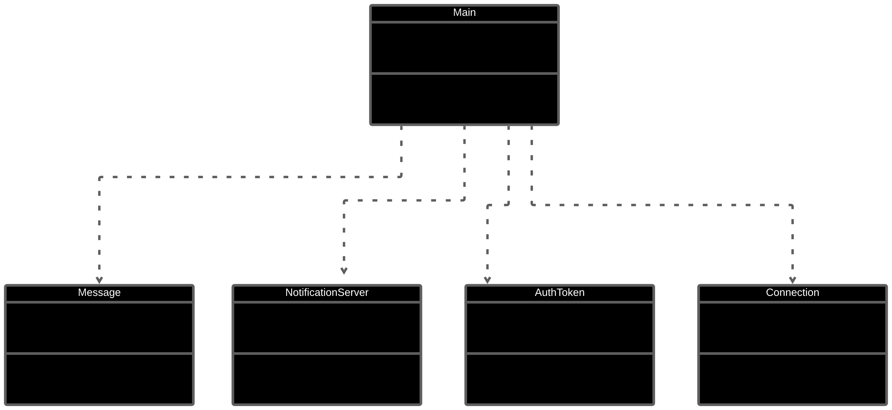
A sample case

Slide 34
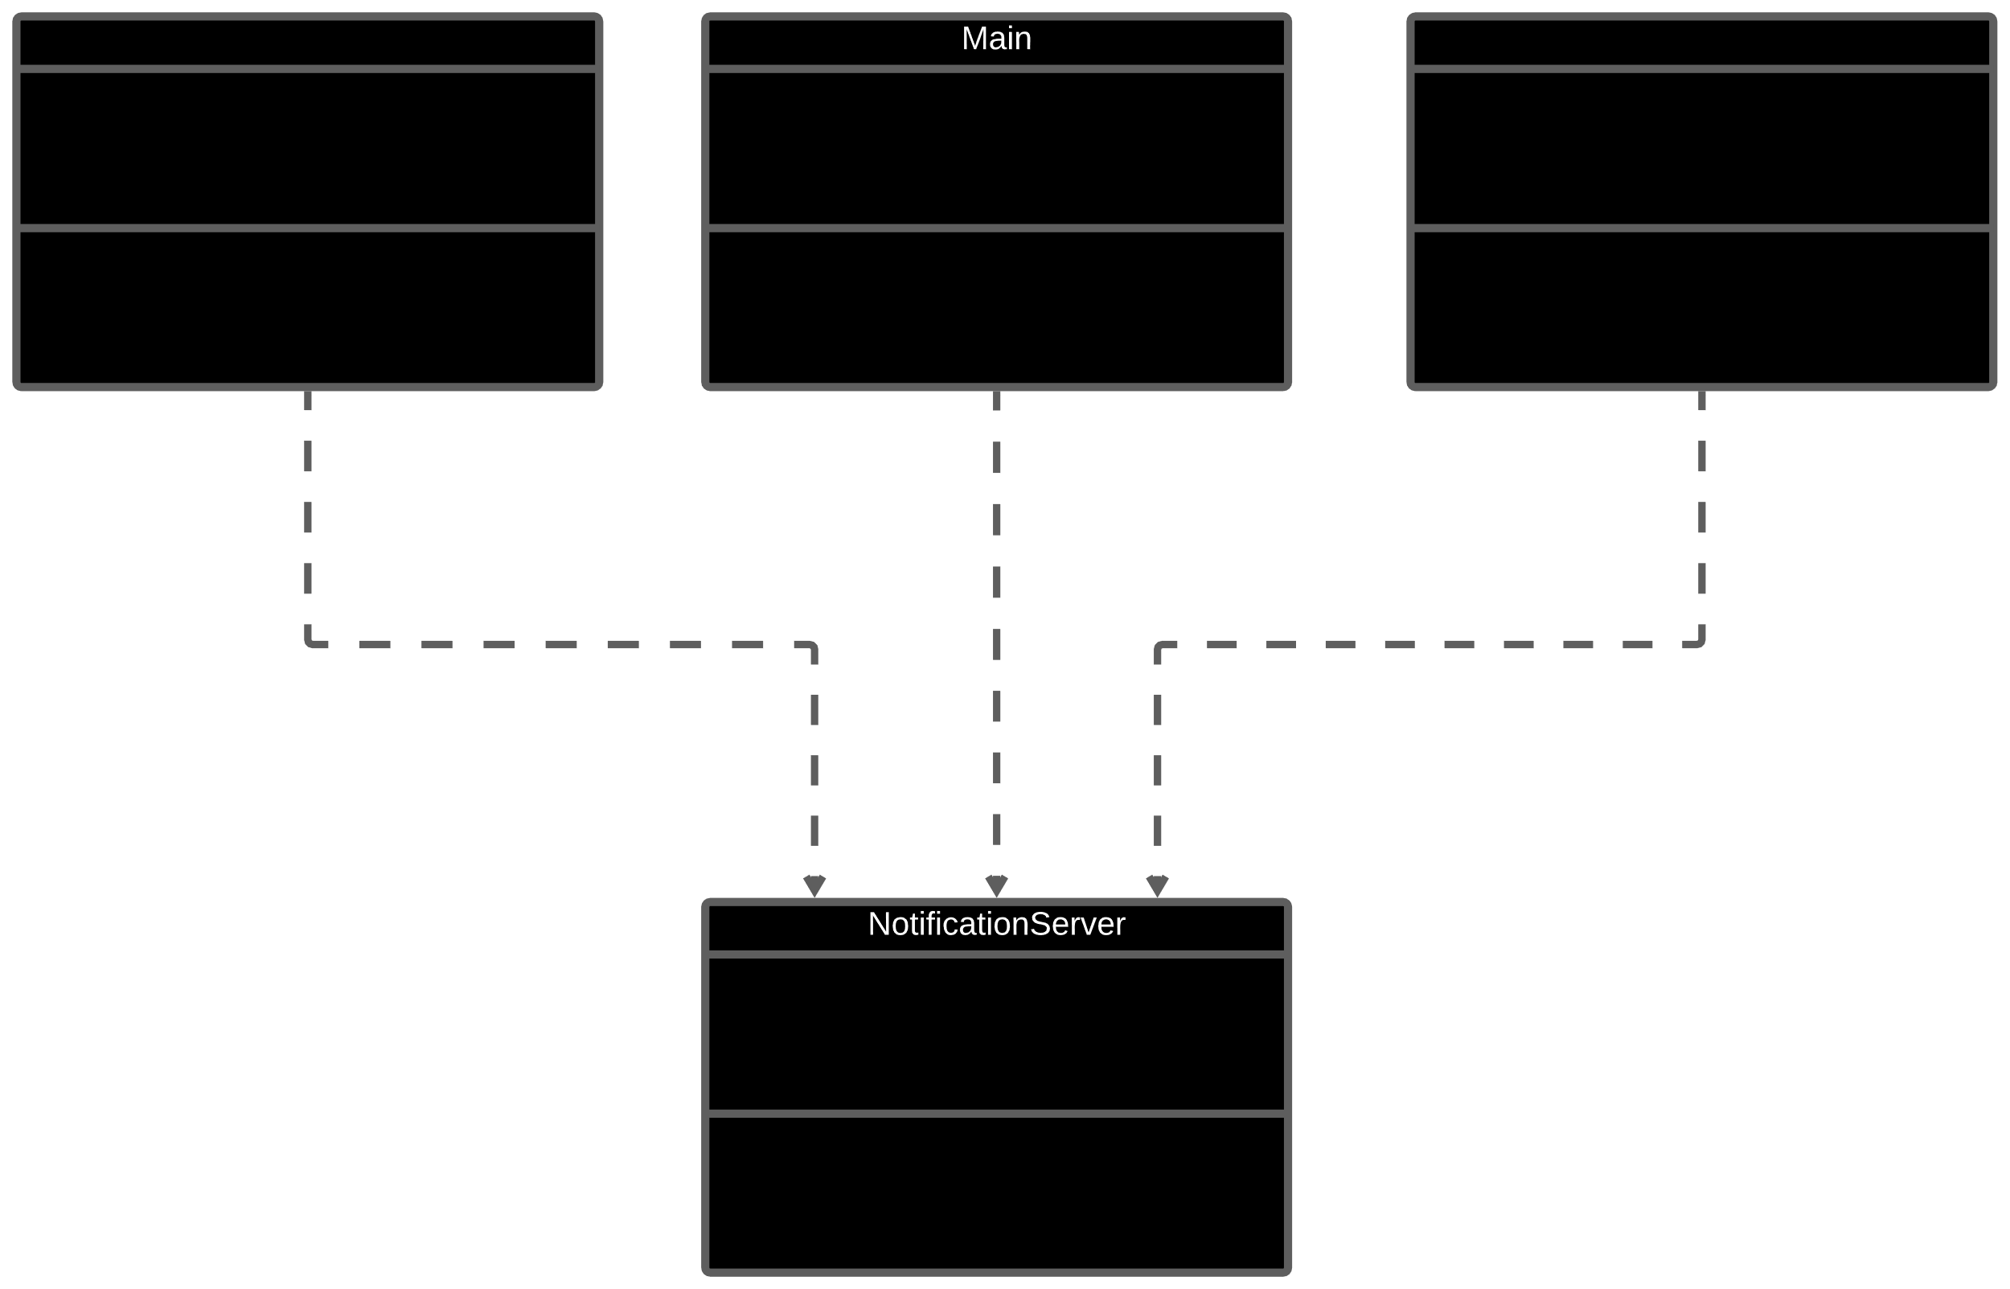
Solution

